Slide 1
Clustering NYC Neighborhoods to Determine Service Needs
Ryan Brenner ~ September 4, 2018 ~ IBM Applied Data Science Capstone

Slide 2
Project Overview
Cluster NYC Neighborhoods using Foursquare data
Cluster NYC Neighborhoods using 311 Request data
Compare clusters to determine whether Foursquare clusters can predict 311 requests

Slide 3
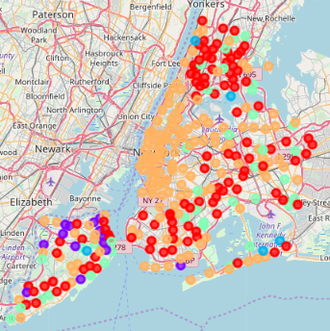
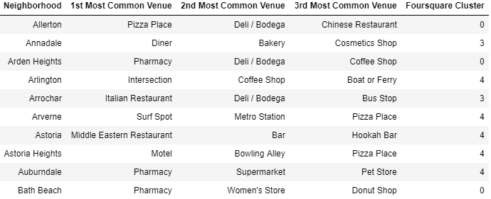
Foursquare Clusters

Slide 4
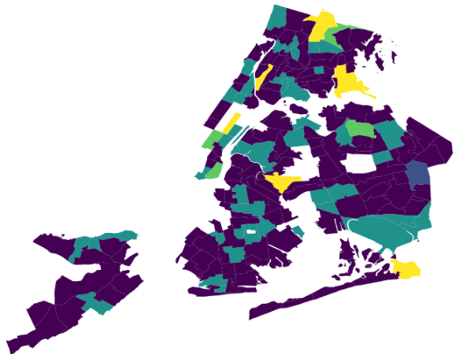
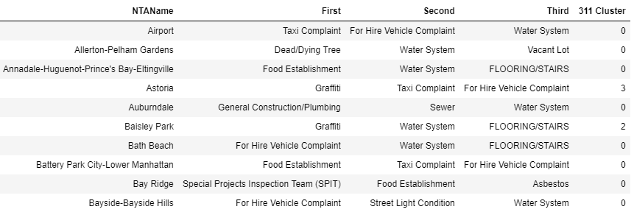
311 Request Clusters

Slide 5
Cluster Matches
Foursquare Group = 311 Group
 | A=0 | A=1 | A=2 | A=3 | A=4
Matches | 18 | 1 | 52 | 3 | 14
 | B=0 | B=1 | B=2 | B=3 | B=4
Matches | 17 | 0 | 72 | 0 | 0
 | C=0 | C=1 | C=2 | C=3 | C=4
Matches | 0 | 0 | 2 | 0 | 0
 | D=0 | D=1 | D=2 | D=3 | D=4
Matches | 0 | 0 | 10 | 0 | 0
 | E=0 | E=1 | E=2 | E=3 | E=4
Matches | 3 | 0 | 14 | 0 | 0

Slide 6
Conclusion
Accuracy of Foursquare clusters predicting 311 cluster: <44% (90/206)
Accuracy of random guess: 20%

